Slide 1
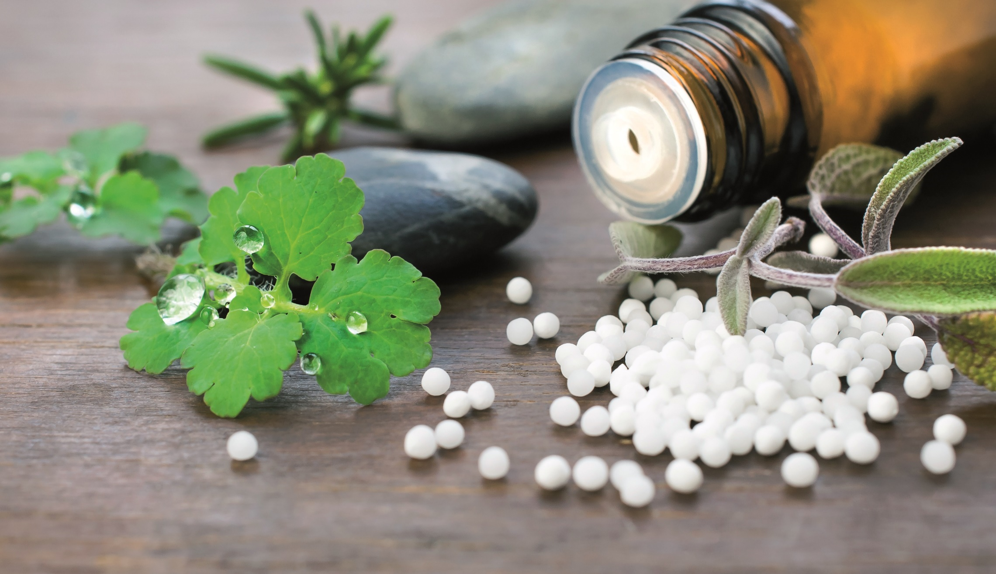
1mg Homeopathy Medicine
Data Analysis
Presented by:
Eshansh Shukla
Sachin Lanje
Abhishek Singh
Ankita Keshari

Slide 2
ABOUT 1mg
It is an online healthcare platform and a trusted name in the healthcare industry in India. They provide various services such as online medicine ordering, booking lab tests, consulting with doctors, and accessing reliable healthcare information.

Slide 3
Objectives of this project
Scraped and Analyse data to identify the most effective and popular homeopathic medicines.
Choose the best products based on customer preferences.
Reduce costs and maximize profits.
Ensure customer satisfaction with a curated selection of quality offerings.
Gain a competitive advantage and achieve sustainable growth

Slide 4

Insights

Slide 5
Top Brands with Higher Medicine Rating
From this chart we can derive SBL Pvt Ltd, has major positive impact in homeopathy market followed by Dr. Reckeweg&Co. , Dr. Willmar Schwabe Indai Pvt Ltd and Bakson’s Homeopathy.

Slide 6
Count of Medicines by key_benefits Area
The major number of medicines are for digestion and skin while joints, hair, blood and respiratory market is still underutilized.

Slide 7
Average Number of Ratings by Brand
Bhargava Phytolab has the highest number of customer ratings, indicating a strong reputation and trust among consumers. This highlights the company's commitment to producing high-quality products that meet customer expectations.
SBL Pvt Ltd and New Life Laboratories Pvt Ltd are the leading brands with the highest number of medicines rated above 4 points. This suggests that these brands consistently deliver effective and reliable medications, making them popular choices among consumers. It also demonstrates their focus on quality and customer satisfaction.

Slide 8
Summary of Prices by Brands
The price range of brands such as Lord's Homoeopathic Laboratory Pvt Ltd, Dr Reckeweg & Co, and Dr Willmar Schwabe India Pvt Ltd varies significantly, with some products priced at a lower rate and others at a higher rate.
Similarly, we can observe that brands such as St. George’s Homoeopathy, Similia Homoeo Laboratory, and HASLAB might produce medicines with the same price range, as their minimum, maximum, and average values are identical

Slide 9
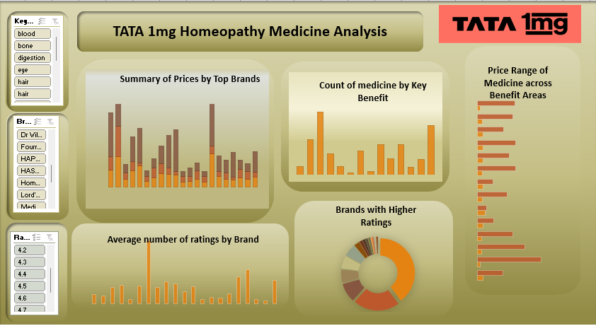

Slide 10
Thank You

